Slide 1
Creating user personas from survey data
Kevin Eliasen
Fred Lambuth
Sean Oslin
Dominic Pedrotti

Slide 2


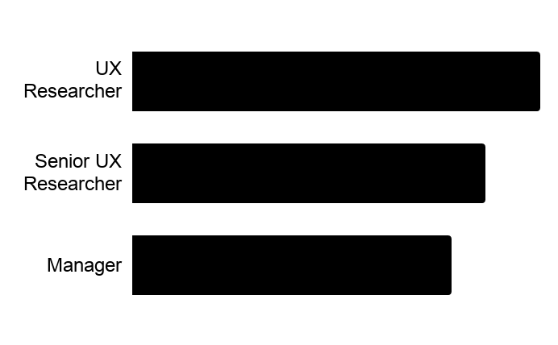
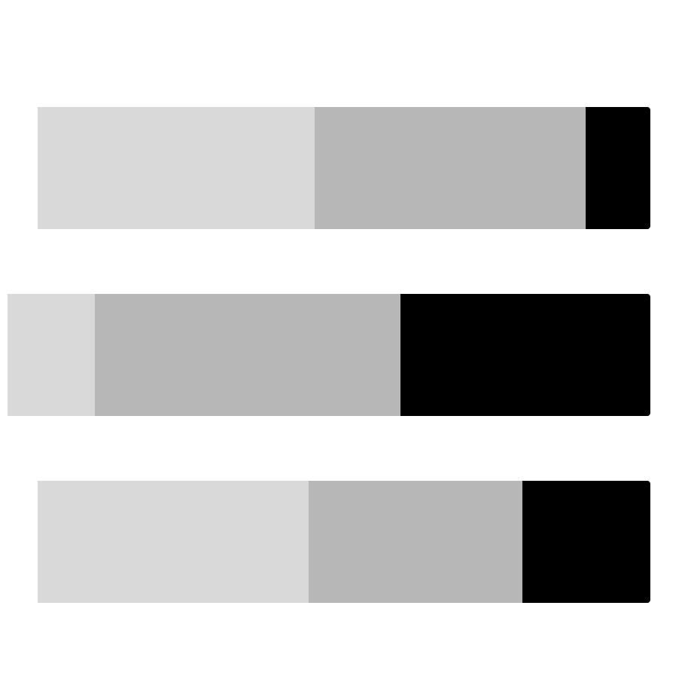
Very Experienced Researchers & Designers
Individual Contributors and Managers from a variety of organization sizes who are experienced in conducting research.
68%
academically trained in research
70%
currently work in large orgs
What factors are most important to this person when deciding whether to attend a conference about research?
Speakers
Topics
Content
What topics would they be most attracted to at a conference about research?
Current methods
Emerging methods
Turning research into action
What advice do they have for the Rosenfeld Media team in pursuing a conference about research?
“Don’t do what everyone else is doing. Don’t be just another conference. Give me a unique offering.”
Job Titles
UX Researcher 37%
Senior UX Researcher 32%
Manager 29%
Which types of sessions are most important for this person?
Workshops
Mid-size conference
Multi-track
Who would they expect to see at a conference about research?
New people
Regular people who are doing great research work
What types of learning activities does this person rely on outside of attending conferences?
Read blog/Medium articles
Read a book
Watch video of talk
Speaker Name Recognition
Diversity of Speakers
Networking Opportunities
Not
Important
Very
Important
Notes:
TRISH

Slide 3


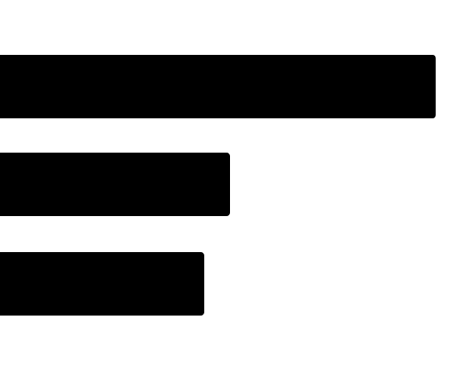
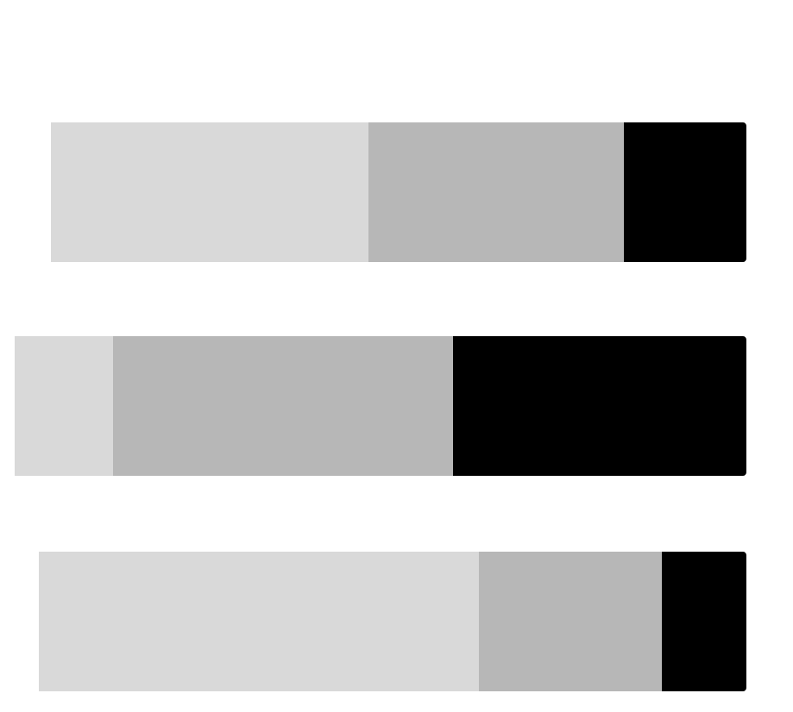
Somewhat Experienced Researchers
Individual contributors and managers with mid level experience conducting research in a variety of methods in organizations of all sizes.
63%
academically trained in research
58%
currently work in large orgs
What factors are most important to this person when deciding whether to attend a conference about research?
Topics
Ability to pay
Diversity of speakers
Which types of sessions are most important for this person?
Workshops
Full-length talks
Keynotes
What topics would they be most attracted to at a conference about research?
Methods & best practices
Research in organizations
Who would they expect to see at a conference about research?
Multidisciplinary
Specific names
What advice do they have for the Rosenfeld Media team in pursuing a conference about research?
“Mix of theory and heavy on practical, mixing talk lengths/formats could cover a lot of area and balance those nicely.”
What types of learning activities does this person rely on outside of attending conferences?
Read blogs and/or books
Watch videos of talks
Attend a local meetup or talk
Job Titles
UX Researcher 34%
UX Designer 18%
Senior UX Researcher 16%
Speaker Name Recognition
Diversity of Speakers
Networking Opportunities
Not
Important
Very
Important
Notes:
ROCIO
n = 62
For the important factors in the side bar, n = 61 (1 had no answer)

Slide 4
Somewhat Experienced Researchers
Individual contributors and managers with mid level experience conducting research in a variety of methods in organizations of all sizes.
63%
academically trained in research
58%
currently work in large orgs
What factors are most important to this person when deciding whether to attend a conference about research?
Topics
Ability to pay
Diversity of speakers
Which types of sessions are most important for this person?
Workshops
Full-length talks
Keynotes
What topics would they be most attracted to at a conference about research?
Methods & best practices
Research in organizations
Who would they expect to see at a conference about research?
Multidisciplinary
Specific names
What advice do they have for the Rosenfeld Media team in pursuing a conference about research?
“Mix of theory and heavy on practical, mixing talk lengths/formats could cover a lot of area and balance those nicely.”
What types of learning activities does this person rely on outside of attending conferences?
Read blogs and/or books
Watch videos of talks
Attend a local meetup or talk
Job Titles
UX Researcher 34%
UX Designer 18%
Senior UX Researcher 16%
Speaker Name Recognition
Diversity of Speakers
Networking Opportunities
Not
Important
Very
Important
Notes:
ROCIO
n = 62
For the important factors in the side bar, n = 61 (1 had no answer)

Slide 5


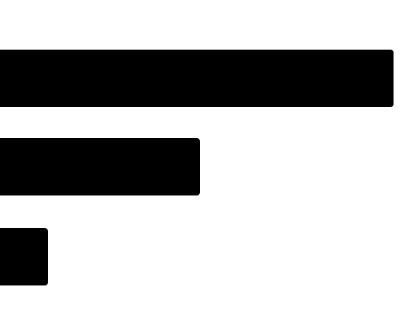
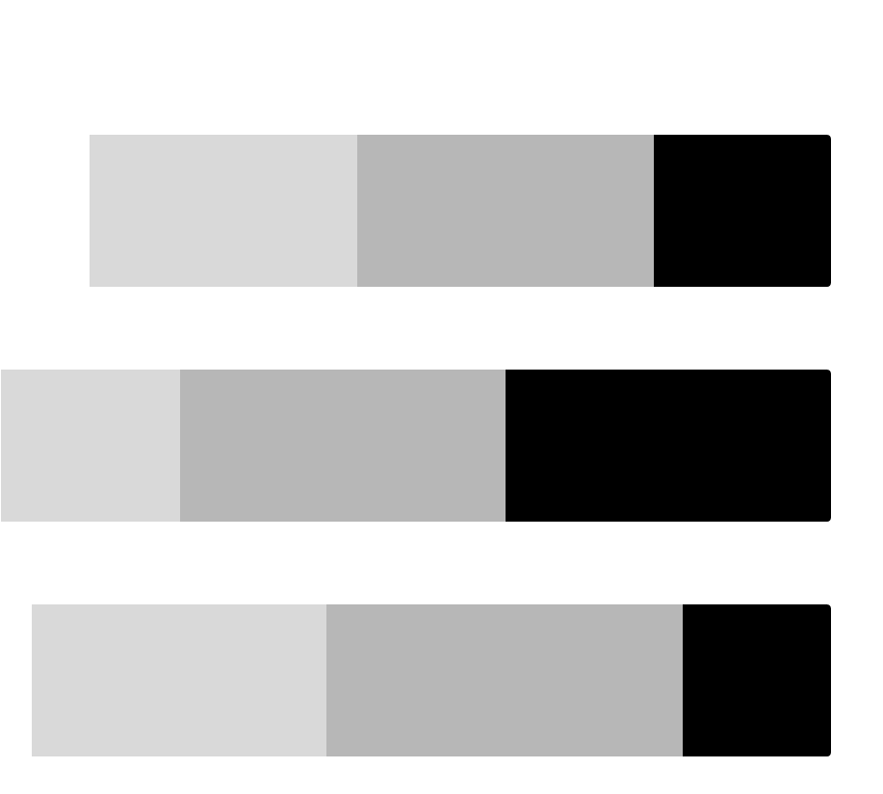
71%
academically trained in research
Less Experienced Researchers
Individual Contributors and Managers from a variety of organization sizes who are not as experienced in conducting research.
43%
currently work in large orgs
What factors are most important to this person when deciding whether to attend a conference about research?
Topics
Session format (tie)
Ability to pay (tie)
Diversity of speakers
Which types of sessions are most important for this person?
Workshops
Keynotes
Discussion circles/topic tables
What topics would they be most attracted to at a conference about research?
Methods & best practices
Analysis & synthesis
Who would they expect to see at a conference about research?
Large organizations
Multidisciplinary
What advice do they have for the Rosenfeld Media team in pursuing a conference about research?
“Have a wide variety of topics, for people of various levels of experience.”
What types of learning activities does this person rely on outside of attending conferences?
Read blogs and/or books
Attend a local meetup or talk
Watch videos of talks
Job Titles
UX Researcher 57%
UX Designer 29%
Senior UX Researcher 7%
Speaker Name Recognition
Diversity of Speakers
Networking Opportunities
Not
Important
Very
Important
Notes:
ROCIO
n = 28

Slide 6

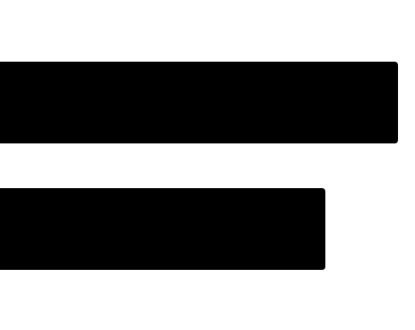
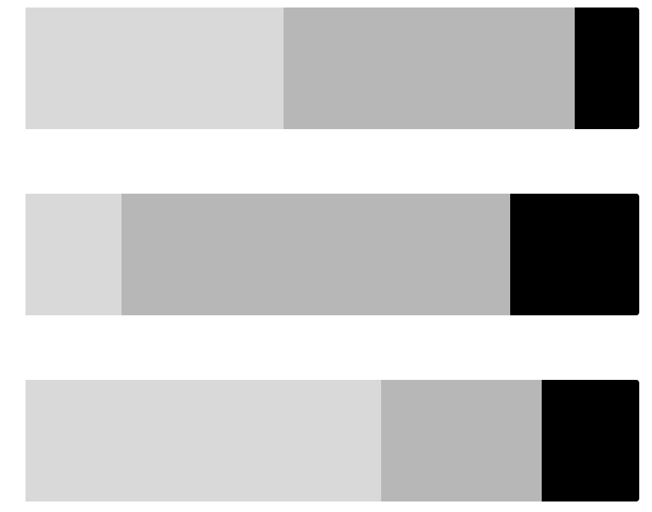
70%
academically trained in research
Design Executives and Consultants
Individuals in leadership positions or providing leadership through consulting who are very experienced conducting research and work in organizations of all sizes
60%
currently work in small orgs
What factors are most important to this person when deciding whether to attend a conference about research?
Conference topics
Location
Cost
Which types of sessions are most important for this person?
Workshops
Keynote speakers
Group discussions / opportunities to share ideas
What topics would they be most attracted to at a conference about research?
Application of research results
Measuring impact of research
New research methods
Who would they expect to see at a conference about research?
Researchers in corp. roles
Company executives
Not Facebook, Apple, Google, ect.
What advice do they have for the Rosenfeld Media team in pursuing a conference about research?
“I would love for it to include a conversation about how research can move from a supportive role to one that drives the direction that companies invest in.”
What types of learning activities does this person rely on outside of attending conferences?
Read blogs & books
Watch videos of talks
Attend a local meetup or talk
Job Titles
Executive 55%
Consultant 45%
Speaker Name Recognition
Diversity of Speakers
Networking Opportunities
Not
Important
Very
Important
Notes:
Neil

